Slide 1
Computational X: Integrating Computational Thinking across Disciplines
Austin Cory Bart, Dennis Kafura, Clifford A. Shaffer
Virginia Tech

Slide 2
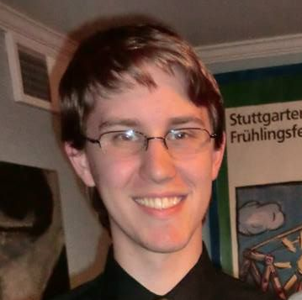
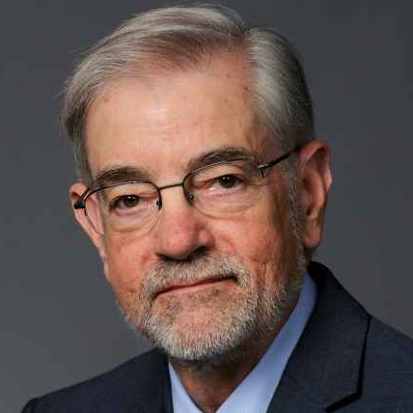

Who are we?
Cory Bart
Dennis Kafura
Clifford A. Shaffer

Slide 3
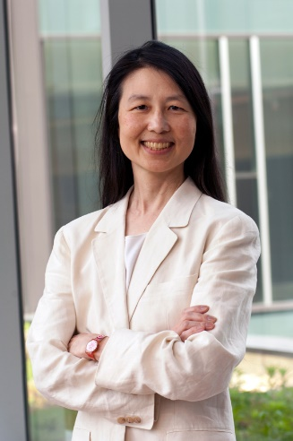
What is it?
Computation
Subject Matter
Arts
Science
Humanities
Engineering
Business
…
"Computational Thinking is the thought processes involved in formulating problems and their solutions so that the solutions are represented in a form that can be effectively carried out by an information-processing agent.“
-Jeanette Wing, 2006
Computational X

Slide 4
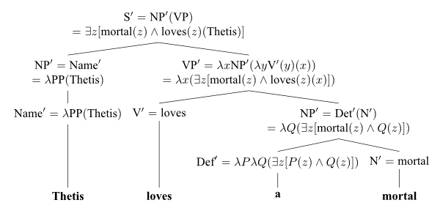

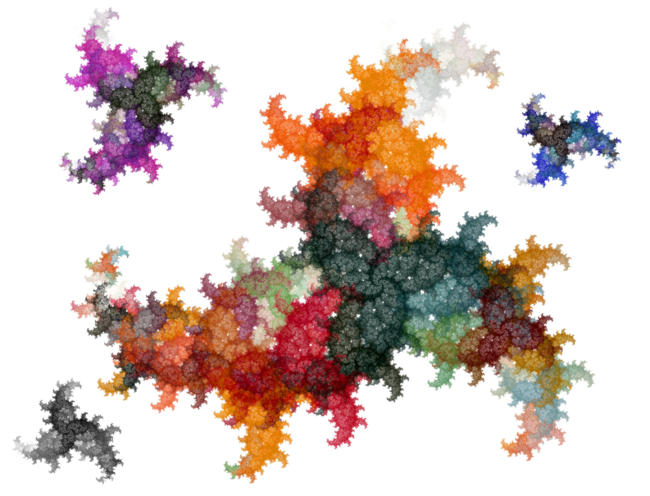
Examples
Computational Biology
Computational Literature
Computational Art
…

Slide 5
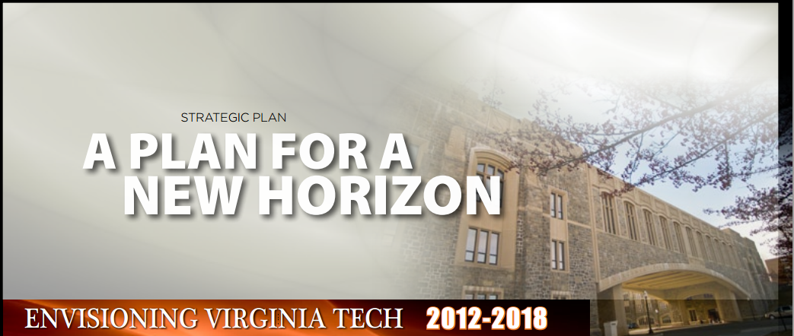
Virginia Tech
To this end, Virginia Tech will comprehensively evaluate and modify the current Curriculum for Liberal Education to … incorporate computational thinking and informatics/digital fluency as basic skills for all students, thereby enabling our students to be engaged citizens and life-long learners.”

Slide 6


Critical elements of CT
Abstraction
Algorithms
Social Impacts
Abstraction
Social
Impacts
Algorithm

Slide 7





Abstraction
Representing the real-world with data by removing unnecessary details
Spreadsheets
Databases
Files
What data do you have in your field?
Movie On-Line Customer
Title (string) | Year (int) | Length (int) | Genre (string) | Format (string) | Price (float)
“Moneyball” | 2011 | 133 | “Sports” | “Blueray” | 15.00
“Gone With the Wind” | 1939 | 219 | “Drama” | “DVD” | 10.95
“Jurassic Park” | 1993 | 127 | “SciFi” | “DVD” | 12.50
“Pirates of the Caribbean” | 2003 | 143 | “Comedy” | “Blueray” | 17.50
“Sicko” | 2007 | 116 | “Documentary” | “Streaming” | 11.75

Slide 8
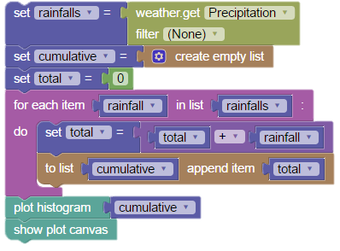
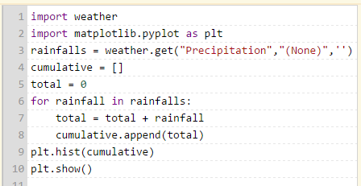
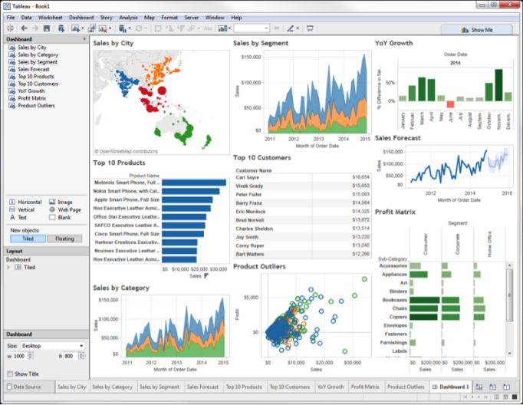
Algorithms
Manipulating data with concrete instructions to solving problems at scale
Programming
Software
What tools do you have in your field?

Slide 9
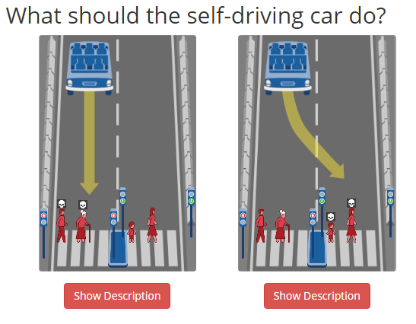
Social Impacts
Interpreting the meaning of computational results
Stakeholders
Policy
Ethics
What are the important questions that need to be answered?

Slide 10
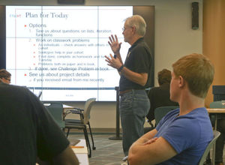

“Introduction to Computational Thinking”
Area 5
For non-CS major students
Data Science context
Modern pedagogy (more on that soon)

Slide 11
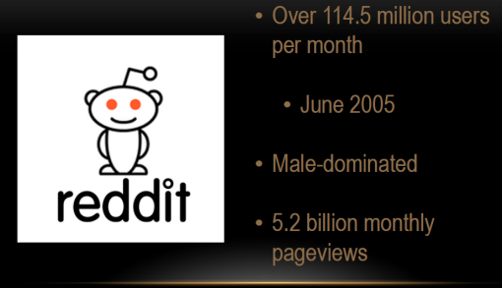

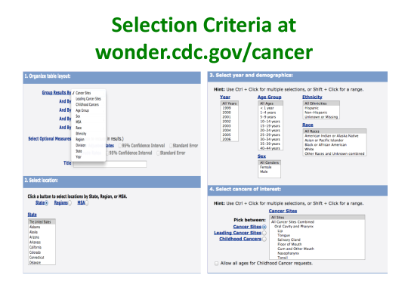
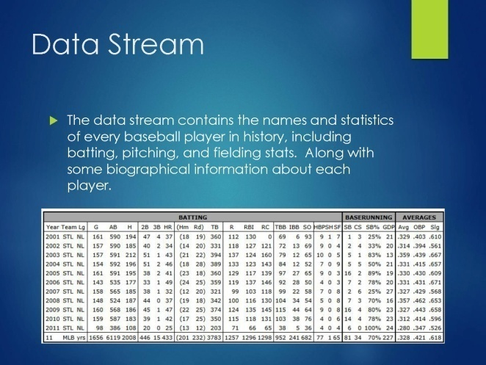
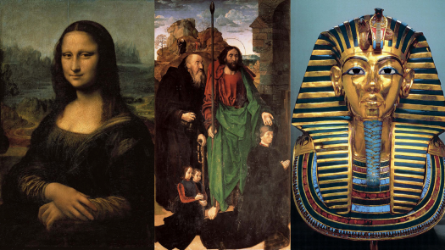
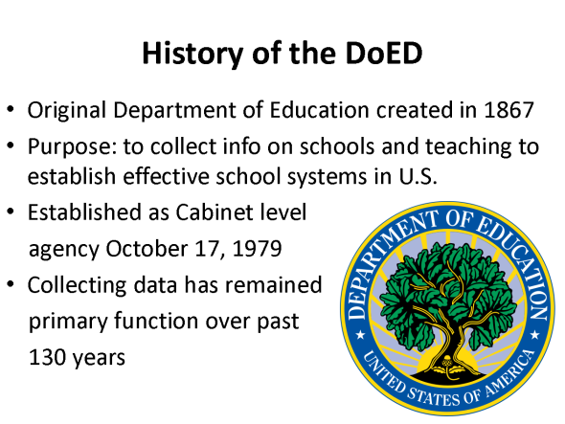


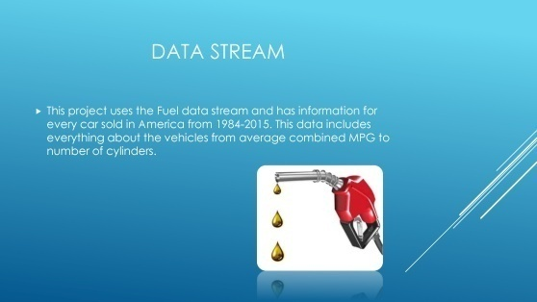
40+ datasets in arts, sciences, humanities, business, and more

Slide 12

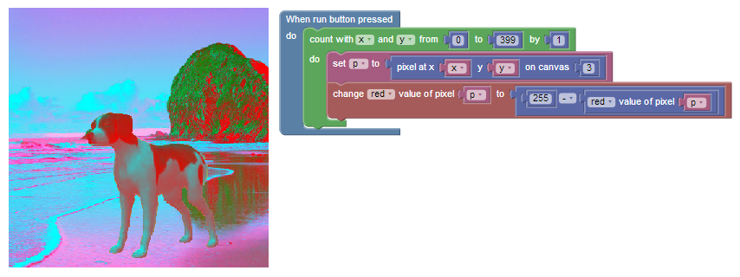
Media Computation
Using computation to create art and sound

Slide 13

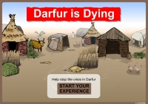
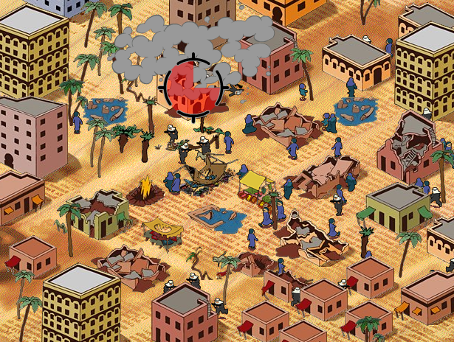

Web/Games/App Development
Actually make games, interactive websites, mobile applications
For some purpose (to solve a real-world problem)
Games for change
Educational Games
Charitable websites

Slide 14
Tools for teaching CT
Microsoft Excel
Python
BlockPy
Visualizer
Out-of-the-box Tools
NetLogo
Mallet
Open-ended Tools
Scaffolded Environments
AppLab
Scratch/Snap
Unity
Programming
R
Java
Tableau

Slide 15
Discussion Questions

Slide 16
Teaching strategies
Peer learning
Active Learning
Flipped Classroom
Situated experience
Project-based learning

Slide 17
Motivation
Provide support, reassurances
Have plans for how students get help
Leverage social learning
Get computing allies
Set expectations reasonably
Sell the experience

Slide 18
CT Professional Development
Read online books (How to Think like a Computer Scientist)
Try out CodeCademy
Start a project
Take a MOOC

Slide 19
Assessment Ideas
Correctness of algorithms
Usefulness of abstractions
Value of interpretations
Rubrics
Unit tests

Slide 20
What’s next?
You probably already do many of these things
Push it a bit farther
More computational assignments
Computational component to a project
Use our course as a pre-requisite

Slide 21
Computational Thinking
What is it?
How do we teach it?
How do we know if they learned it?

Slide 22
Formal Learning Objectives
Explain the application of computational or quantitative thinking across multiple knowledge domains.
Apply the foundational principles of computational or quantitative thinking to frame a question and devise a solution in a particular field of study.
Construct a model based on computational methods to analyze complex or large-scale phenomenon.
Identify the impacts of computing and information technology on humanity.

Slide 23
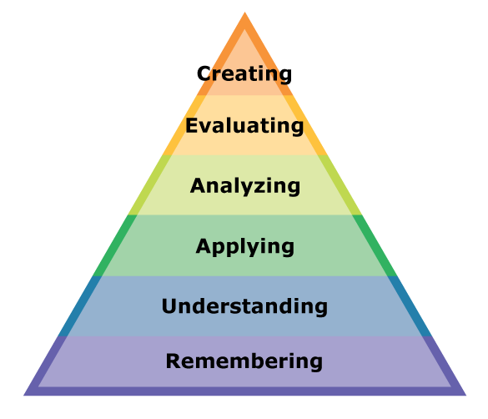
Course integration
Open-ended projects
Solving practice problems
Learning how to use a tool
Learning relevant terminology

Slide 24

History
"Computational Thinking is the thought processes involved in formulating problems and their solutions so that the solutions are represented in a form that can be effectively carried out by an information-processing agent.“
-Jeanette Wing, 2006

Slide 25
Computational X
Computation
Subject Matter
Arts
Science
Humanities
Engineering
Business
…
Computational X

Slide 26
Global Demand
End-user programmers are growing!
More and more jobs involve computation
Need a compelling quote here

Slide 27
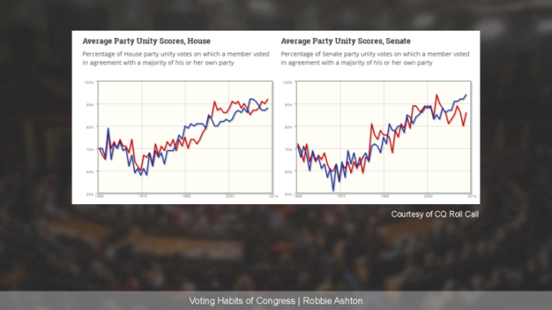
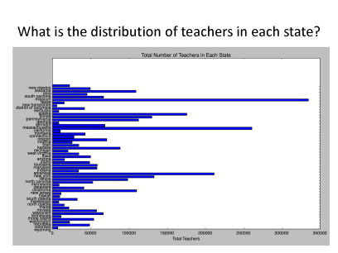
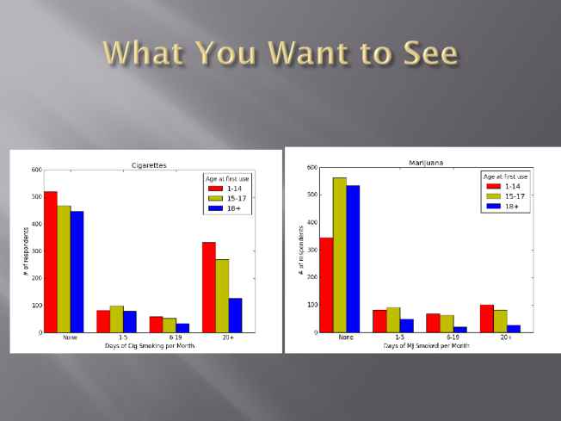
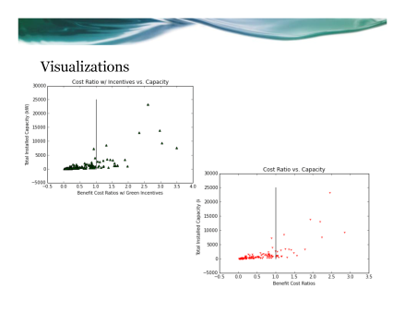
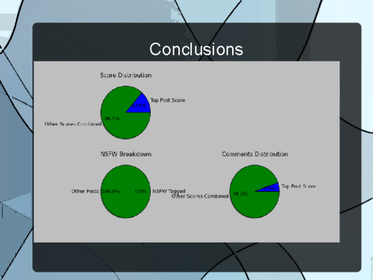
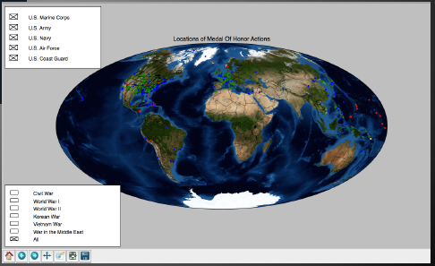
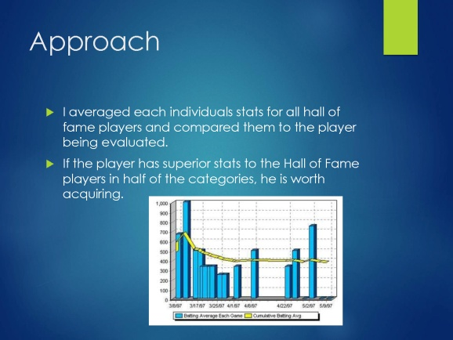
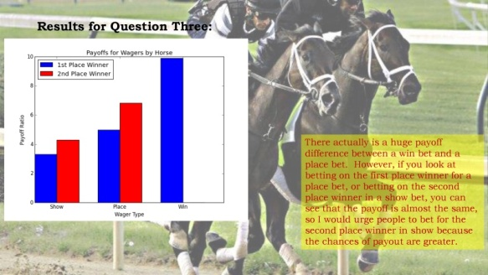
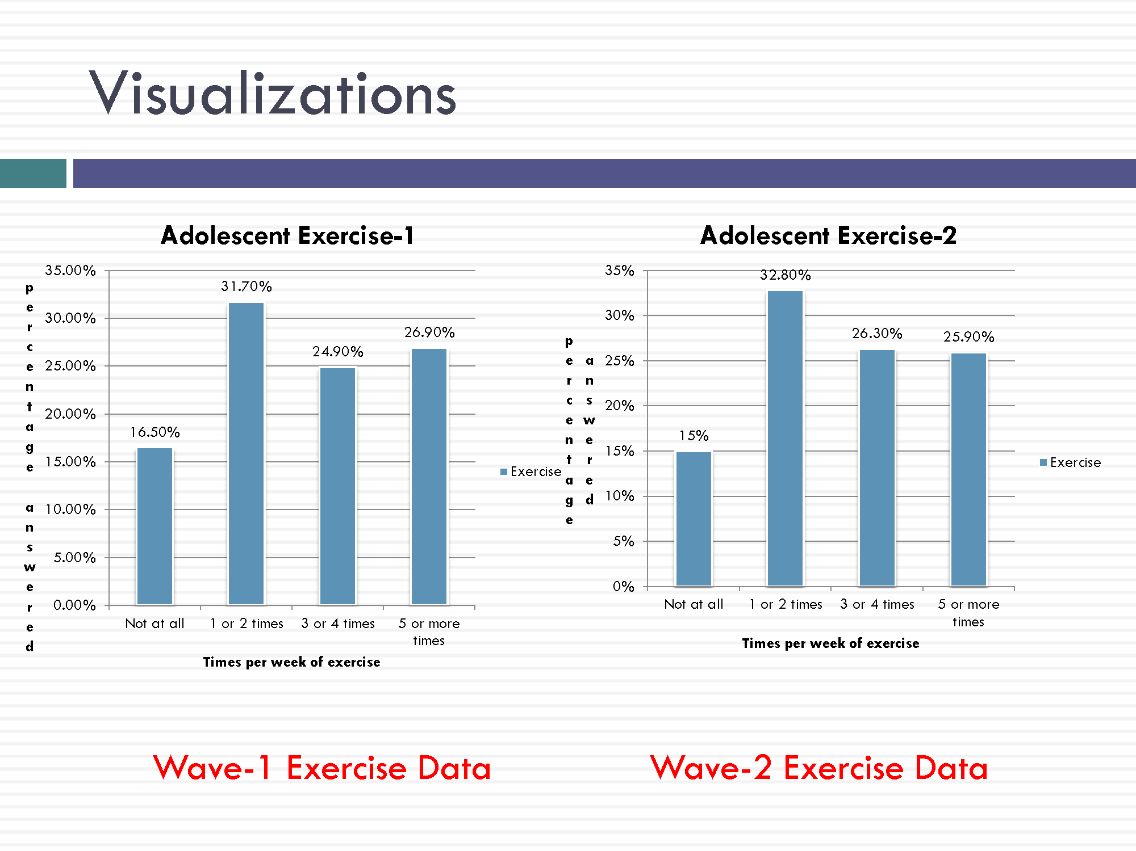
final project: open-ended data science

